Slide 1
Washington Metro Area Transportation Analysis
Requirement: 8-10 Minutes Long
Team 3
Abubeker Mohammed
Yegor Kryukov
Sonya Smirnova
Marc Pitarys
Presentation Date: 21 APR 2018

Slide 2
Motivation
Requirement: Describe the questions you and your group found interesting,
and what motivated you to answer them
The Washington Metropolitan Transit Authority (WMATA) provides bus and rail transit to the Washington region
WMATA Metro is facing many challenges concerning safety, ridership, and funding
Specific Questions to be answered in this analysis:
Does time of year impact demand for transportation resources?
Does Metro performance impact the demand for other transportation resources?
Can one predict the availability of transportation resources based on metro past performance?
Bottomline: What factors impact Metro performance and does Metro impact other transportation resources?

Slide 3
Approach to answering the research questions
Requirement: Summarize where and how you found the data you used to answer these questions
Gather monthly ridership data for determining time of year impacts
Metro
Vital Signs Report. A Scorecard of Metro’s Key Performance Indicators (KPI). 2012: A Year in Review
Vital Signs Report. A Scorecard of Metro’s Key Performance Indicators (KPI). 2013: A Year in Review
A Scorecard of Metro’s Key Performance Indicators (KPI). 2014: A Year in Review
Vital Signs. January – December 2015 Annual Report
Vital Signs. January – December 2016 Annual Report
Q2 FY2018 Metro Performance Report. Fiscal-Year-To-Date Jul 2016-Dec 2017
US Government
Federal Transit Administration Monthly Module Raw Data Release. Provides ridership data on all urban transit agencies.
Bureau of Economic Analysis
Census Bureau
DC Government: Department of For-Hire Vehicles
Uber
Use statistical tools for analyzing ridership trends and relationships between factors
Time Series Analysis
Linear Regression (Single Variable and Multi-Variable)
Polynomial Regression
Review results from the analysis and make observations

Slide 4

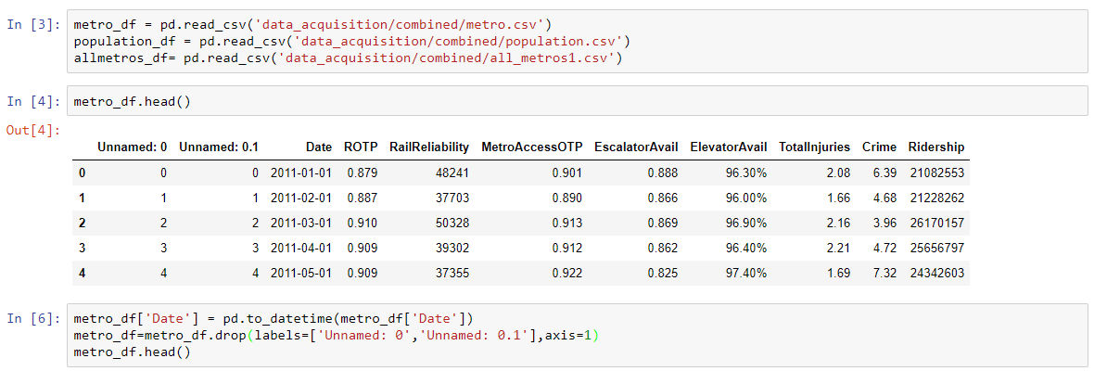

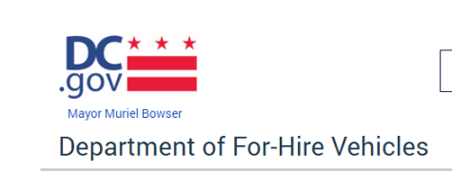
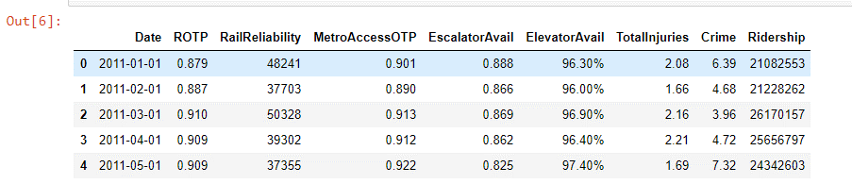
Data Exploration and Clean Up Process
Raw Data
Reports (PDF Files)
Paste into CSV Files
Read into Pandas DataFrame
CSV Files
Uber
Clean Data
Convert Dates to DateTime
Delete unneeded columns
Requirement: Describe the data exploration and cleanup-process

Slide 5
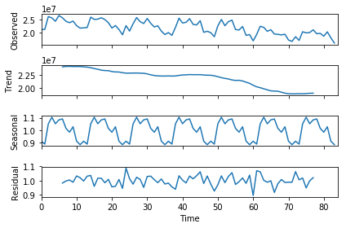
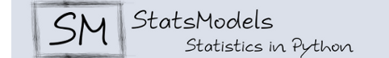
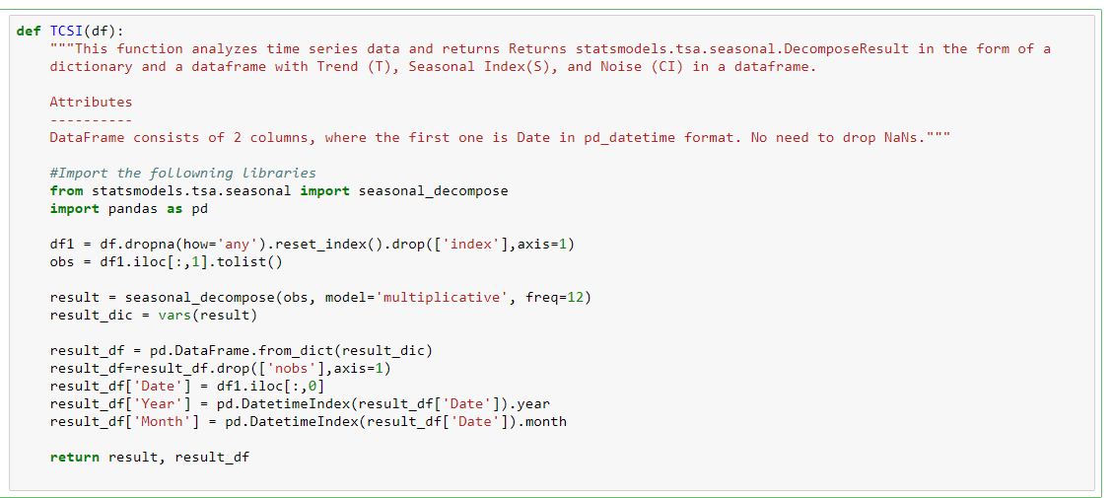
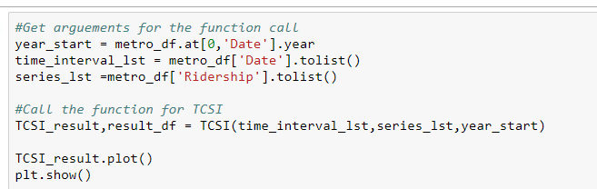
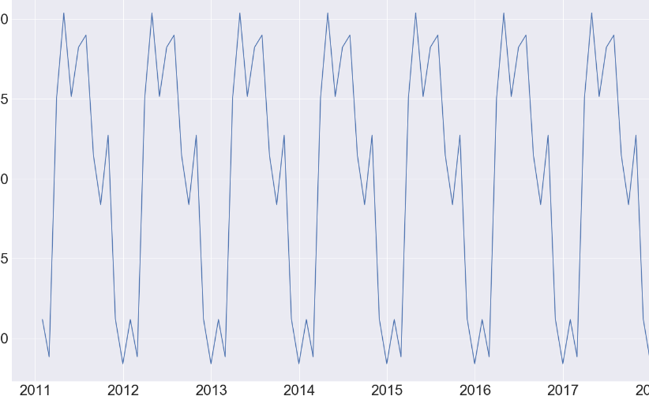
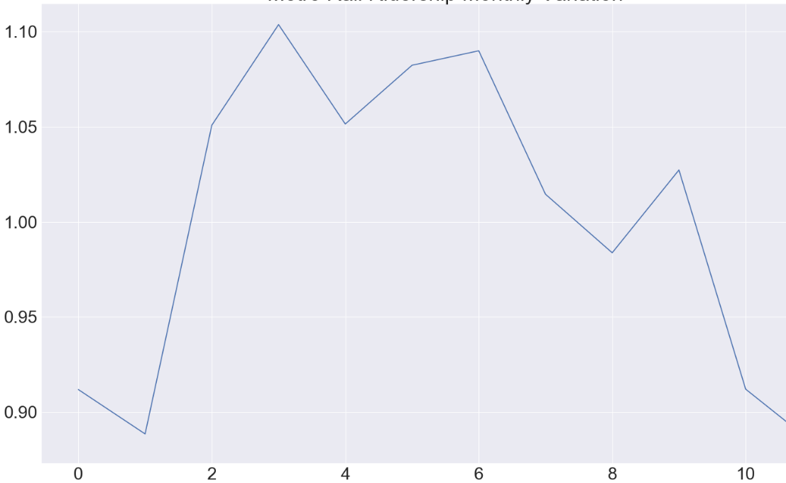
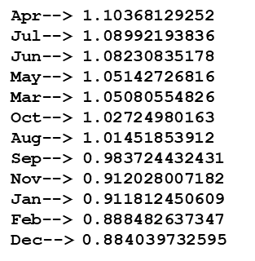
Time Series Data
Analysis Process: Find Seasonal Index for Question 1
Y
T
Y = T x C x S x I = TCSI
S
Y: Time Series Variable
T: Trend C : Cyclical Movement
S : Seasonal Variation I : Irregular Movement
CI
The ridership data is characteristic of a time series
Long Term Trend or Movement
Seasonal Movement
Long-Term Cyclical Movement
Irregular Movement:
Seasonal Variation Found by the Average Percentage Method.
Each month ridership data expressed as a percentages for the whole year ridership.
Percentages from corresponding months of different years are averaged.
The resulting twelve percentages are the seasonal index.
Seasonal Index

